Slide 1

Proof of Concept INSPIRE Good Practice Coverages
Let op: Pas zelf het vertrouwelijkheidsniveau aan. Zie voor uitleg deze intranetpagina
November 2021

Slide 2
Agenda
RWS Proof-of-Concept on INSPIRE Coverages
Coverages in INSPIRE
Providing Coverages
-- a short break ---
Using Coverages
Demo
Discussion
Questions: please use the chat

Slide 3
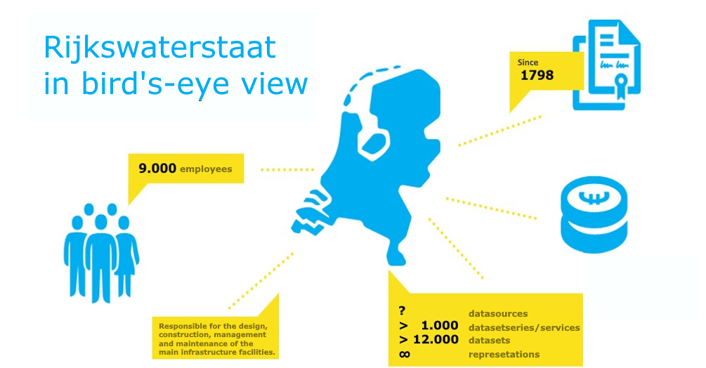

Slide 4
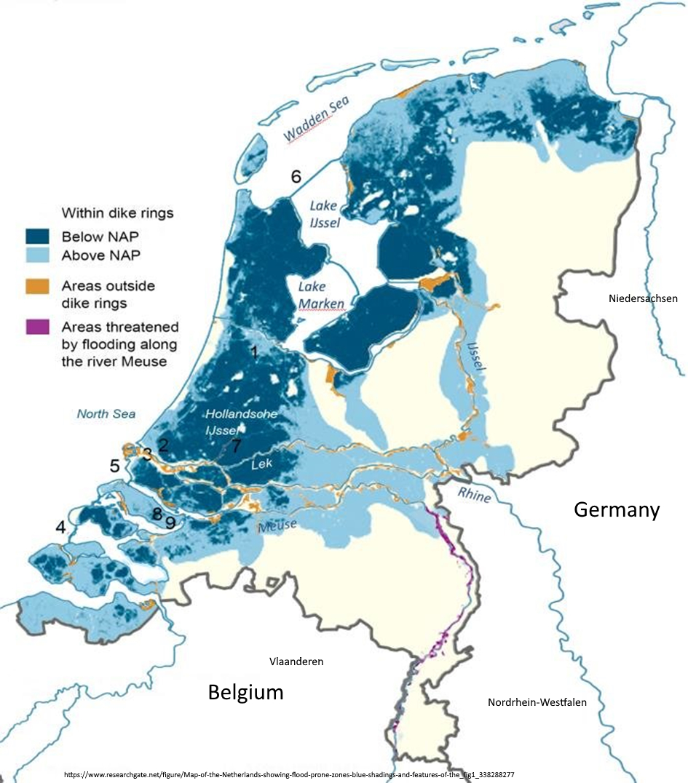
NL is already under water

Slide 5
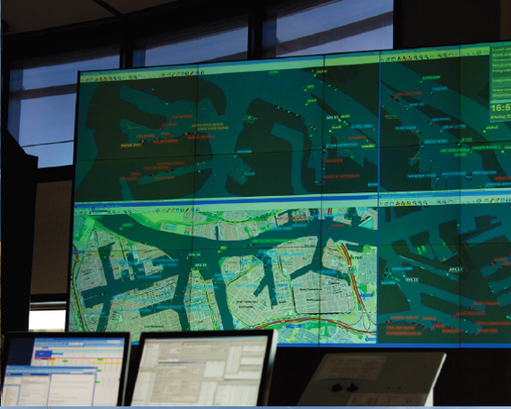
Data(use) driven
Advantage: All connected suppliers and users are available in the same process, quality and form (format) so that combining the data from different data sources is easy to perform (uniform service).
FAIR Data: findable, accessible, interoperable, reusable

Slide 6
Introduction
In the Netherlands Rijkswaterstaat has been designated to make the soil height of the Netherlands available as grids for European targets.
In 2021 RWS has carried out a Proof of Concept of the INSPIRE Good Practice coverages (PoC) in order to gain insight into the organizational and technical barriers and to solve them where possible.
The information is actively managed and offered via https://github.com/codefornl/INSPIRE-coverages

Slide 7

Expectations Share the experiences Collect questions and answers Discuss how to use the results Define actions

Slide 8
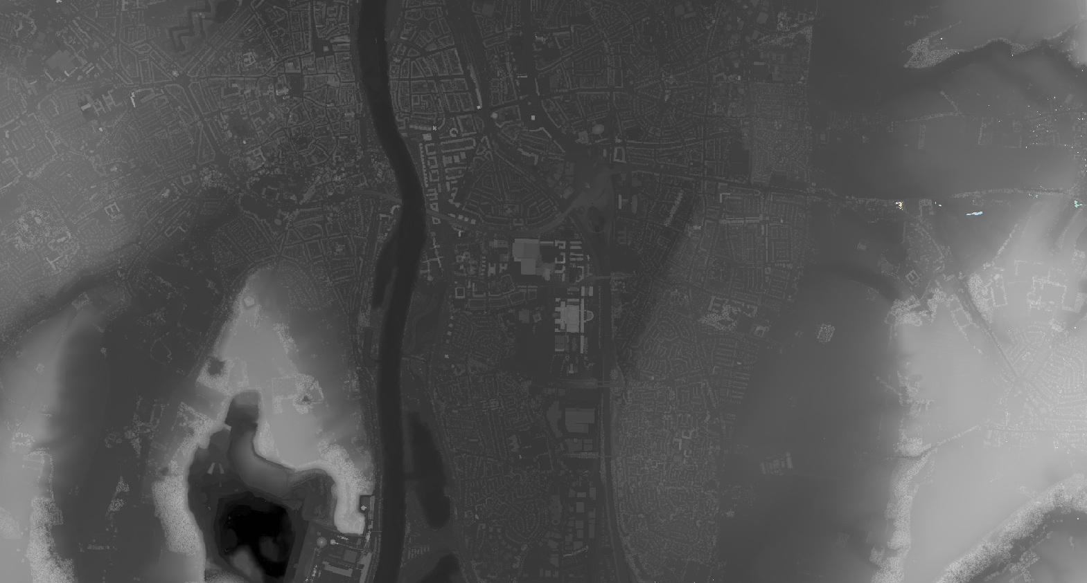

Slide 9
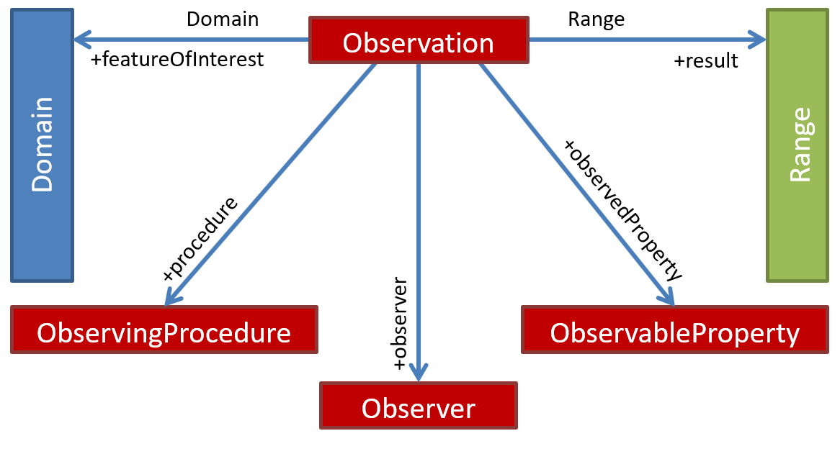
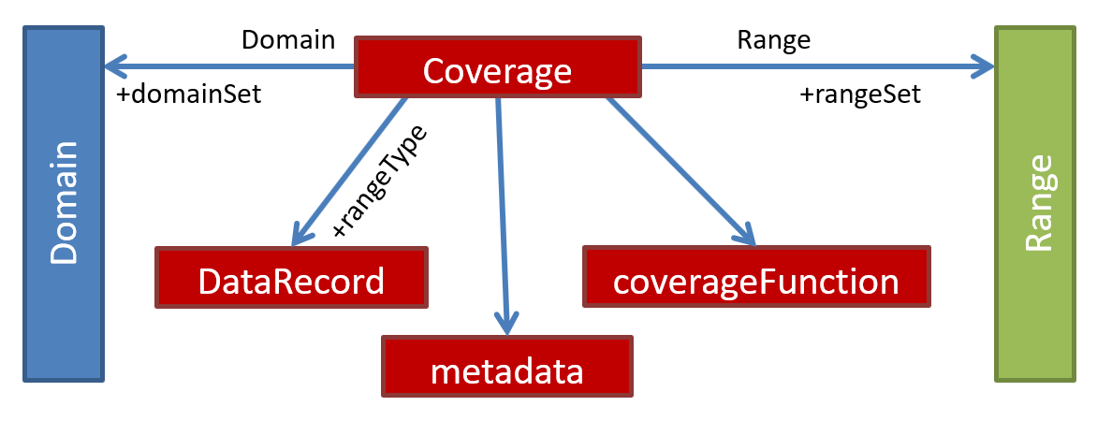
Coverages are just big fat Sensors!
Figure 39 — OMS model key elements
Figure 40 — CIS model key elements.

Slide 10
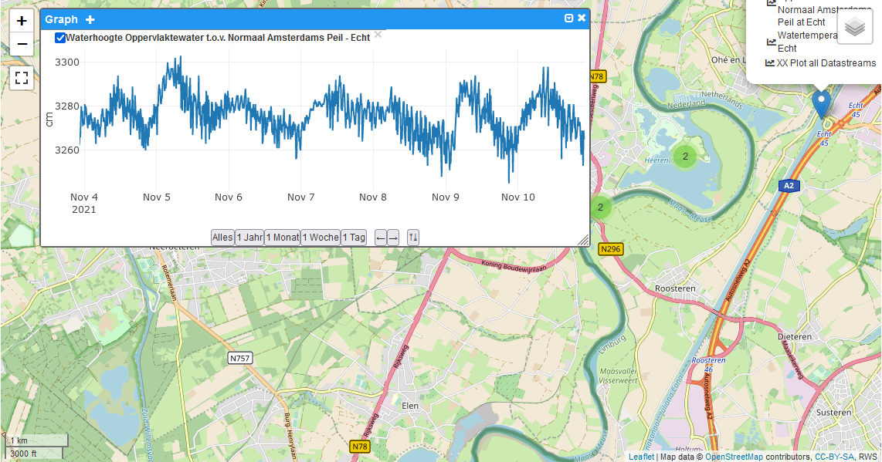
http://info.datacove.eu/WaterinfoSTA.html

Slide 11
OGC SensorThings API
Viewer: http://info.datacove.eu/WaterinfoSTA.html
API Endpoint: https://ogc-demo.k8s.ilt-dmz.iosb.fraunhofer.de/v1.1/
More info at: https://datacoveeu.github.io/API4INSPIRE/

Slide 12
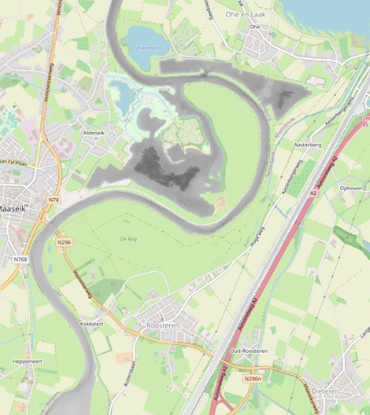
Coverages in INSPIRE
Themes
Grids
Services
Issues
Good Practice

Slide 13









Coverages in INSPIRE
INSPIRE Themes with Coverage Models:
Elevation (EL)
Geology (GE)
Land cover (LC)
Land use (LU)
Natural risk zones (NZ)
Orthoimagery (OI)
Soil (SO)
Energy resources (ER)
Species distribution (SD) – App. schema deprecated

Slide 14
Coverages in INSPIRE
Don’t forget Annex I Geographical Grid Systems, specifies:
Equal Area Grid: ETRS89 Lambert Azimuthal Equal Area (ETRS89-LAEA) hierarchical, with resolutions of 1m, 10m, 100m, 1000m, 10000m and 100000m
Zoned Geographic Grid: based on ETRS89-GRS80 geodetic CRS. Factors defined for 5 latitudinal zones to mitigate the meridian convergence.
Elevation Data Specification requires Zoned Geographic Grid, whereby following CRS may be used:
two-dimensional geodetic coordinates (latitude and longitude) based on a datum specified in Section 1.2 of Annex II and using the parameters of the GRS80 ellipsoid (e.g., EPSG::4258);
plane coordinates using the ETRS89 Lambert Conformal Conic coordinate reference system;
plane coordinates using the ETRS89 Transverse Mercator coordinate reference system.

Slide 15
Coverages in INSPIRE
Providing Coverages with INSPIRE Download Service:
Too “Heavy” for WFS (100s MB)
Web Coverage Service (WCS) allows for subsetting
Web Coverage Processing Service (WCPS) adds server side processing
Guidance (2016):
Technical Guidance for the implementation of INSPIRE Download Services using Web Coverage Services (WCS)

Slide 16
Coverages in INSPIRE
Issues:
INSPIRE Download Service requires additional information in the service capabilities response
→ GeoSolutions (GeoServer) and Rasdaman are implementing the required extensions based on WCS Guidance
INSPIRE Coverage based data models not suited to provision via WCS
→ INSPIRE Good Practice on Coverage

Slide 17
Coverages in INSPIRE
GetCapabilities Response from WCS
<ows:ExtendedCapabilities>
<inspire_dls:ExtendedCapabilities>
<inspire_common:MetadataUrl xsi:type="inspire_common:resourceLocatorType">
<inspire_common:URL>
https://inspire…nl/fbd0d3da-e025-4728-8fd5-22ad5f530511
</inspire_common:URL>
<inspire_common:MediaType>application/xml</inspire_common:MediaType>
</inspire_common:MetadataUrl>
<inspire_common:SupportedLanguages>
<inspire_common:DefaultLanguage>
<inspire_common:Language>eng</inspire_common:Language>
</inspire_common:DefaultLanguage>
</inspire_common:SupportedLanguages>
<inspire_common:ResponseLanguage>
<inspire_common:Language>eng</inspire_common:Language>
</inspire_common:ResponseLanguage>
<inspire_dls:SpatialDataSetIdentifier metadataURL="https://inspire...nl/f670705f-f4e9-11e6-81e4">
<inspire_common:Code>INSPIRE_WNZ_5_NAP</inspire_common:Code>
<inspire_common:Namespace>https://inspire…nl/rasdaman/ows</inspire_common:Namespace>
</inspire_dls:SpatialDataSetIdentifier>
...
</inspire_dls:ExtendedCapabilities>
</ows:ExtendedCapabilities>
<ows:ExtendedCapabilities>
<inspire_dls:ExtendedCapabilities>
<inspire_common:MetadataUrl xsi:type="inspire_common:resourceLocatorType">
<inspire_common:URL>
https://inspire…nl/fbd0d3da-e025-4728-8fd5-22ad5f530511
</inspire_common:URL>
<inspire_common:MediaType>application/xml</inspire_common:MediaType>
</inspire_common:MetadataUrl>
<inspire_common:SupportedLanguages>
<inspire_common:DefaultLanguage>
<inspire_common:Language>eng</inspire_common:Language>
</inspire_common:DefaultLanguage>
</inspire_common:SupportedLanguages>
<inspire_common:ResponseLanguage>
<inspire_common:Language>eng</inspire_common:Language>
</inspire_common:ResponseLanguage>
<inspire_dls:SpatialDataSetIdentifier metadataURL="https://inspire...nl/f670705f-f4e9-11e6-81e4">
<inspire_common:Code>INSPIRE_WNZ_5_NAP</inspire_common:Code>
<inspire_common:Namespace>https://inspire…nl/rasdaman/ows</inspire_common:Namespace>
</inspire_dls:SpatialDataSetIdentifier>
...
</inspire_dls:ExtendedCapabilities>
</ows:ExtendedCapabilities>
Service Metadata
Language
Dataset Metadata
CoverageID
Service URL

Slide 18
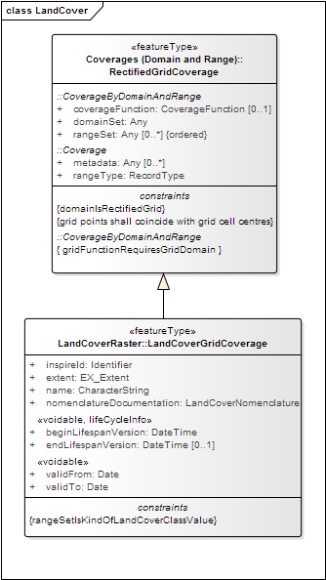
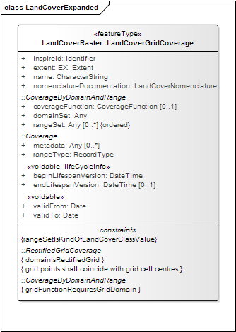
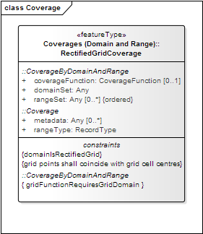

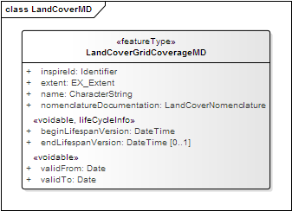
INSPIRE Good Practice Coverages
Note: Metadata is a very broad concept!
The Coverage Metadata described here is NOT related to INSPIRE Metadata in accordance with ISO 19115 and provided by a Catalogue Service!

Slide 19
INSPIRE Good Practice Coverages
XML Snippet providing the additional INSPIRE Information from UML Transformation
<?xml version="1.0" encoding="UTF-8"?>
<el-covmd-ks:ElevationGridCoverageMetadata xmlns:el-covmd-ks="http://inspire.ec.europa.eu/schemas/el-covmd/4.0"
<el-covmd-ks:beginLifespanVersion>2021-04-09T00:00:00+01:00</el-covmd-ks:beginLifespanVersion>
<el-covmd-ks:domainExtent>
<gmd:EX_Extent>
<gmd:geographicElement>
<gmd:EX_GeographicBoundingBox>
<gmd:westBoundLongitude><gco:Decimal>3.9632793</gco:Decimal></gmd:westBoundLongitude>
<gmd:eastBoundLongitude><gco:Decimal>4.8789582</gco:Decimal></gmd:eastBoundLongitude>
<gmd:southBoundLatitude><gco:Decimal>51.8526434</gco:Decimal></gmd:southBoundLatitude>
<gmd:northBoundLatitude><gco:Decimal>52.0129335</gco:Decimal></gmd:northBoundLatitude>
</gmd:EX_GeographicBoundingBox>
</gmd:geographicElement>
</gmd:EX_Extent>
</el-covmd-ks:domainExtent>
<el-covmd-ks:inspireId>
<base:Identifier>
<base:localId>INSPIRE_WNZ_5_NAP</base:localId>
<base:namespace>https://www.rijkswaterstaat.nl</base:namespace>
</base:Identifier>
</el-covmd-ks:inspireId>
<el-covmd-ks:propertyType>depth</el-covmd-ks:propertyType>
<el-covmd-ks:surfaceType>DTM</el-covmd-ks:surfaceType>
</el-covmd-ks:ElevationGridCoverageMetadata>

Slide 20
INSPIRE Good Practice Coverages
Information on the Good Practice:
https://inspire.ec.europa.eu/good-practice/ogc-compliant-inspire-coverage-data-and-service-implementation
Schema Files:
https://schema.datacove.eu/ElevationGridCoverageMetadata.xsd
https://schema.datacove.eu/OrthoimageryMetadata.xsd
http://test.datacove.eu/LandCoverRasterMDExt.xsd

Slide 21
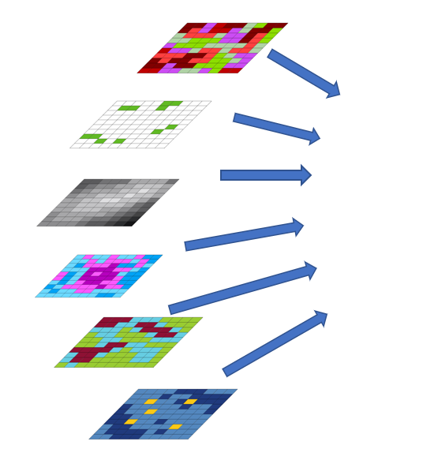
Providing Coverages
Data Sources
Providing Data

Slide 22
Data Sources
Source data often point/vector based
Must first be transformed to grid
Grid should align to Zoned Geographic Grid
Relevant Factors for Zones
https://epsg.io/4258
GeoTIFF useful format

Slide 23
Providing data
Gridded data rapidly becomes unmanageable due to size
Subset into tiles for transfer and import
WCS can import multiple input grids, merge to one coverage
Gdal library very useful
Ideally transform to target CRS close to source
While can also be transformed later, reduces accuracy
XML Snippets must be created for the additional INSPIRE attributes

Slide 24

Resampling gone WRONG!

Slide 25
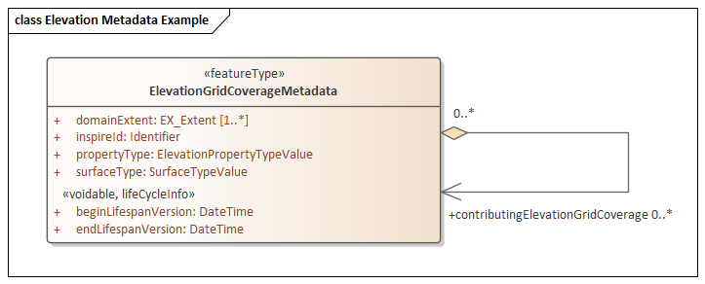
Providing data
<?xml version="1.0" encoding="UTF-8"?>
<el-covmd-ks:ElevationGridCoverageMetadata xmlns:el-covmd-ks="http://inspire.ec.europa.eu/schemas/el-covmd/4.0"
<el-covmd-ks:beginLifespanVersion>2021-04-09T00:00:00+01:00</el-covmd-ks:beginLifespanVersion>
<el-covmd-ks:domainExtent>
<gmd:EX_Extent>
<gmd:geographicElement>
<gmd:EX_GeographicBoundingBox>
<gmd:westBoundLongitude><gco:Decimal>3.9632793</gco:Decimal></gmd:westBoundLongitude>
<gmd:eastBoundLongitude><gco:Decimal>4.8789582</gco:Decimal></gmd:eastBoundLongitude>
<gmd:southBoundLatitude><gco:Decimal>51.8526434</gco:Decimal></gmd:southBoundLatitude>
<gmd:northBoundLatitude><gco:Decimal>52.0129335</gco:Decimal></gmd:northBoundLatitude>
</gmd:EX_GeographicBoundingBox>
</gmd:geographicElement>
</gmd:EX_Extent>
</el-covmd-ks:domainExtent>
<el-covmd-ks:inspireId>
<base:Identifier>
<base:localId>INSPIRE_WNZ_5_NAP</base:localId>
<base:namespace>https://www.rijkswaterstaat.nl</base:namespace>
</base:Identifier>
</el-covmd-ks:inspireId>
<el-covmd-ks:propertyType>depth</el-covmd-ks:propertyType>
<el-covmd-ks:surfaceType>DTM</el-covmd-ks:surfaceType>
</el-covmd-ks:ElevationGridCoverageMetadata>
XML Snippet for Elevation
As foreseen by the Coverage Good Practice

Slide 26
Providing data
Putting it all together, for one coverage, you need:
1 Coverage ID
Gridded data, e.g. Tif
Can be multiple files
1 XML Snippet
Language (usually default English)
Metadata URLS for
Service Metadata (ISO 19119)
Dataset Metadata (ISO 19115)

Slide 27
Providing data (rasdaman)
Install rasdaman, details at: https://doc.rasdaman.org/02_inst-guide.html
Configure import “Recipe” with the correct “Ingredients”, details at: https://doc.rasdaman.org/05_geo-services-guide.html#data-import

Slide 28
Providing data (rasdaman)
{
"config": {
"service_url": "http://localhost:8080/rasdaman/ows",
"tmp_directory": "/tmp/",
"mock": false,
"automated": true,
"track_files": false
},
"input": {
"coverage_id": "INSPIRE_WNZ_5_NAP",
"paths": [
"*.tif"
]
},
"recipe": {
"name": "general_coverage",
"options": {
"coverage": {
"crs": "EPSG/0/4258",
"metadata": {
"type": "xml",
"global": {
"Title": "'metadata placeholder'"
}
},
"slicer": {
"type": "gdal",
"bands": [{
"name": "Elevation",
"identifier": "Grey"
}],
Recipe Ingredients (Configuration file)
Local rasdaman service URL
Coverage ID
Path to gridded data files, e.g. Tif
CRS, e.g., EPSG/0/4258
Bands, in the case of Elevation, should be
name: Elevation
identifier: Grey

Slide 29
Providing data (rasdaman)
Import Coverage by running import script with “Ingredients”: $ wcst_import.sh path/to/my_ingredients.json
Update Coverage with XML Snippet curl --user petauser:petapasswd -F "coverageId=test_mr_metadata" -F "file=@/home/rasdaman/Downloads/test_metadata.xml" "http://localhost:8080/rasdaman/admin/UpdateCoverageMetadata"

Slide 30
Provision Issues – Wrong CRS
While ideally grid generated to correct CRS, can be transformed. Using GDAL, following requests provide compressed transformed grid: gdalwarp -tap -tr 30 30 -t_srs EPSG:4258 -of vrt input_file.tif output_file.vrt gdal_translate -co compress=LZW output_file.vrt output_file.tif
Alternatively:
gdalwarp -t_srs EPSG:4258 input_file.tif output_file.tif

Slide 31
Provision Issues – Too little Memory
gdal_retile.py -ps 512 512 -targetDir .. AHN3_ZuidLimburg_subset.tif

Slide 32
Provision – Server Scoping
General Rule of Thumb:
RAM: 64GB
Hard Disk: Approx 3 x Data Volume
CPUs: Depends on degree of parallelization
Runs on 4 cores
8 CPUs basic recommendation
How to estimate:
Difficult, thus →
VMs allow for simple scaling based on actual usage and performance

Slide 34
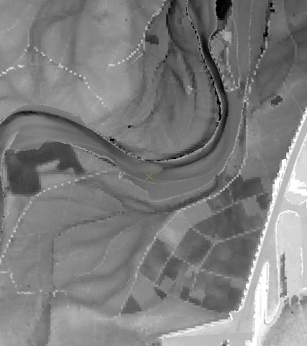
Using Coverages
WCS Requests
Some Endpoints
Issues

Slide 35
OGC Web Services (OWS)
Web Map Service (WMS)
Web Feature Service (WFS)
Web Coverage Service (WCS)
Web Coverage Processing Service (WCPS)
Sensor Observation Service (SOS)
Catalogue Service Web (CSW)

Slide 36
WCS Requests
GetCapabilities
DescribeCoverage
GetCoverage

Slide 37
WCS Requests - GetCapabilities
Basic information about the service endpoint
Common to all OGC Web Services (OWS)
Request Structure:
http://{WCS Endpoint}/ows? SERVICE=WCS& VERSION=2.0.1& REQUEST=GetCapabilities

Slide 38
WCS Requests - GetCapabilities Response
<?xml version="1.0" encoding="UTF-8"?>
<wcs:Capabilities version="2.0.1" xmlns:crs="http://www.opengis.net/wcs/service-extension/crs/1.0" xmlns:gml="http://www.opengis.net/gml/3.2" xmlns:int="http://www.opengis.net/wcs/interpolation/1.0" xmlns:ows="http://www.opengis.net/ows/2.0" xmlns:rasdaman="http://www.rasdaman.org" xmlns:swe="http://www.opengis.net/swe/2.0" xmlns:wcs="http://www.opengis.net/wcs/2.0" xmlns:xlink="http://www.w3.org/1999/xlink" xmlns:xsi="http://www.w3.org/2001/XMLSchema-instance" xmlns:inspire_dls="http://inspire.ec.europa.eu/schemas/inspire_dls/1.0" xmlns:inspire_common="http://inspire.ec.europa.eu/schemas/common/1.0" xsi:schemaLocation="http://www.opengis.net/wcs/2.0 http://schemas.opengis.net/wcs/2.0/wcsGetCapabilities.xsd
http://inspire.ec.europa.eu/schemas/inspire_dls/1.0
http://inspire.ec.europa.eu/schemas/inspire_dls/1.0/inspire_dls.xsd">
<ows:ServiceIdentification>
<ows:Title>rasdaman</ows:Title>
<ows:Abstract>rasdaman server - free download from www.rasdaman.org</ows:Abstract>
<ows:ServiceType>OGC WCS</ows:ServiceType>
<ows:ServiceTypeVersion>2.0.1</ows:ServiceTypeVersion>
<ows:ServiceTypeVersion>2.1.0</ows:ServiceTypeVersion>
<ows:Profile>http://www.opengis.net/spec/GMLCOV/1.0/conf/gml</ows:Profile>
<ows:Profile>http://www.opengis.net/spec/GMLCOV/1.0/conf/gml-coverage</ows:Profile>
<ows:Profile>http://www.opengis.net/spec/WCS_coverage-encoding_geotiff/1.0/</ows:Profile>
<ows:Profile>http://www.opengis.net/spec/GMLJP2/2.0/</ows:Profile>
<ows:Profile>http://www.opengis.net/spec/WCS_coverage-encoding_jpeg2000/1.0/</ows:Profile>
<ows:Profile>https://www.ietf.org/rfc/rfc4180.txt</ows:Profile>
<ows:Profile>https://www.www.json.org/</ows:Profile>
<ows:Profile>https://www.w3.org/Graphics/JPEG/</ows:Profile>
<ows:Profile>http://www.w3.org/TR/PNG/</ows:Profile>
<ows:Profile>http://www.opengis.net/spec/WCS_coverage-encoding_netcdf/1.0/</ows:Profile>
<ows:Profile>http://www.opengis.net/spec/GMLCOV/1.0/conf/multipart</ows:Profile>
<ows:Profile>http://www.opengis.net/spec/WCS_service-extension_interpolation/1.0/conf/interpolation</ows:Profile>
<ows:Profile>http://www.opengis.net/spec/WCS_service-extension_range-subsetting/1.0/conf/record-subsetting</ows:Profile>
<ows:Profile>http://www.opengis.net/spec/WCS_service-extension_scaling/1.0/conf/scaling</ows:Profile>
<ows:Profile>http://www.opengis.net/spec/WCS_service-extension_processing/2.0/conf/processing</ows:Profile>
<ows:Profile>http://www.opengis.net/spec/WCS_protocol-binding_get-kvp/1.0/conf/get-kvp</ows:Profile>
<ows:Profile>http://www.opengis.net/spec/WCS_protocol-binding_soap/1.0</ows:Profile>
<ows:Profile>http://www.opengis.net/spec/WCS_protocol-binding_post-xml/1.0</ows:Profile>
<ows:Profile>http://www.opengis.net/spec/WCS_service-extension_transaction/2.0/conf/insert+delete</ows:Profile>
<ows:Profile>http://www.opengis.net/spec/WCS_service-extension_crs/1.0/conf/crs</ows:Profile>
</ows:ServiceIdentification>
<ows:ServiceProvider>
<ows:ProviderName>Jacobs University Bremen</ows:ProviderName>
<ows:ProviderSite xlink:href="http://rasdaman.org/"/>
<ows:ServiceContact>
<ows:IndividualName>Prof. Dr. Peter Baumann</ows:IndividualName>
<ows:PositionName>Project Leader</ows:PositionName>
<ows:ContactInfo>
<ows:Phone>
<ows:Voice>+49 421 20040</ows:Voice>
</ows:Phone>
<ows:Address>
<ows:DeliveryPoint>Campus Ring 1</ows:DeliveryPoint>
<ows:City>Bremen</ows:City>
<ows:PostalCode>28759</ows:PostalCode>
<ows:Country>Germany</ows:Country>
<ows:ElectronicMailAddress>p.baumann@jacobs-university.de</ows:ElectronicMailAddress>
</ows:Address>
</ows:ContactInfo>
<ows:Role>pointOfContact</ows:Role>
</ows:ServiceContact>
</ows:ServiceProvider>
<ows:OperationsMetadata>
<ows:Operation name="GetCapabilities">
<ows:DCP>
<ows:HTTP>
<ows:Get xlink:href="https://coverage-demo.wetransform.eu/rasdaman/ows"/>
<ows:Post xlink:href="https://coverage-demo.wetransform.eu/rasdaman/ows"/>
</ows:HTTP>
</ows:DCP>
</ows:Operation>
<ows:Operation name="DescribeCoverage">
<ows:DCP>
<ows:HTTP>
<ows:Get xlink:href="https://coverage-demo.wetransform.eu/rasdaman/ows"/>
<ows:Post xlink:href="https://coverage-demo.wetransform.eu/rasdaman/ows"/>
</ows:HTTP>
</ows:DCP>
</ows:Operation>
<ows:Operation name="GetCoverage">
<ows:DCP>
<ows:HTTP>
<ows:Get xlink:href="https://coverage-demo.wetransform.eu/rasdaman/ows"/>
<ows:Post xlink:href="https://coverage-demo.wetransform.eu/rasdaman/ows"/>
</ows:HTTP>
</ows:DCP>
</ows:Operation>
<ows:Constraint name="PostEncoding">
<ows:AllowedValues>
<ows:Value>XML</ows:Value>
<ows:Value>SOAP</ows:Value>
</ows:AllowedValues>
</ows:Constraint>
<ows:ExtendedCapabilities>
<!-- ***** INSPIRE ***** -->
<inspire_dls:ExtendedCapabilities>
<inspire_common:MetadataUrl>
<inspire_common:URL>https://metadata.rws.nl/INSPIRE-SERVICE-f670705f-f4e9-11e6-81e4-52540023a883_20211012-160900</inspire_common:URL>
<inspire_common:MediaType>application/vnd.iso.19139+xml</inspire_common:MediaType>
</inspire_common:MetadataUrl>
<inspire_common:SupportedLanguages>
<inspire_common:DefaultLanguage>
<inspire_common:Language>eng</inspire_common:Language>
</inspire_common:DefaultLanguage>
</inspire_common:SupportedLanguages>
<inspire_common:ResponseLanguage>
<inspire_common:Language>eng</inspire_common:Language>
</inspire_common:ResponseLanguage>
<inspire_dls:SpatialDataSetIdentifier metadataURL="https://metadata.rws.nl/INSPIRE-DATASET-f670705f-f4e9-11e6-81e4-52540023a883_20211012-160902">
<inspire_common:Code>INSPIRE_WNZ_5_NAP</inspire_common:Code>
<inspire_common:Namespace>https://coverage-demo.wetransform.eu/rasdaman/ows</inspire_common:Namespace>
</inspire_dls:SpatialDataSetIdentifier>
</inspire_dls:ExtendedCapabilities>
</ows:ExtendedCapabilities>
</ows:OperationsMetadata>
<wcs:ServiceMetadata>
<wcs:formatSupported>application/gml+xml</wcs:formatSupported>
<wcs:formatSupported>image/jpeg</wcs:formatSupported>
<wcs:formatSupported>image/png</wcs:formatSupported>
<wcs:formatSupported>image/tiff</wcs:formatSupported>
<wcs:formatSupported>image/gtiff</wcs:formatSupported>
<wcs:formatSupported>image/bmp</wcs:formatSupported>
<wcs:formatSupported>image/jp2</wcs:formatSupported>
<wcs:formatSupported>application/netcdf</wcs:formatSupported>
<wcs:formatSupported>text/csv</wcs:formatSupported>
<wcs:formatSupported>application/json</wcs:formatSupported>
<wcs:formatSupported>application/dem</wcs:formatSupported>
<wcs:formatSupported>application/x-ogc-dted</wcs:formatSupported>
<wcs:formatSupported>application/x-ogc-ehdr</wcs:formatSupported>
<wcs:formatSupported>application/x-ogc-elas</wcs:formatSupported>
<wcs:formatSupported>application/x-ogc-envi</wcs:formatSupported>
<wcs:formatSupported>application/x-ogc-ers</wcs:formatSupported>
<wcs:formatSupported>application/x-ogc-fit</wcs:formatSupported>
<wcs:formatSupported>application/x-ogc-fits</wcs:formatSupported>
<wcs:formatSupported>image/gif</wcs:formatSupported>
<wcs:formatSupported>application/x-netcdf-gmt</wcs:formatSupported>
<wcs:formatSupported>application/x-ogc-gs7bg</wcs:formatSupported>
<wcs:formatSupported>application/x-ogc-gsag</wcs:formatSupported>
<wcs:formatSupported>application/x-ogc-gsbg</wcs:formatSupported>
<wcs:formatSupported>application/x-ogc-gta</wcs:formatSupported>
<wcs:formatSupported>application/x-ogc-hf2</wcs:formatSupported>
<wcs:formatSupported>application/x-erdas-hfa</wcs:formatSupported>
<wcs:formatSupported>application/x-ogc-ida</wcs:formatSupported>
<wcs:formatSupported>application/x-ogc-ingr</wcs:formatSupported>
<wcs:formatSupported>application/x-ogc-isis2</wcs:formatSupported>
<wcs:formatSupported>application/x-erdas-lan</wcs:formatSupported>
<wcs:formatSupported>application/x-ogc-mff2</wcs:formatSupported>
<wcs:formatSupported>application/x-ogc-nitf</wcs:formatSupported>
<wcs:formatSupported>application/x-ogc-paux</wcs:formatSupported>
<wcs:formatSupported>application/x-ogc-pcidsk</wcs:formatSupported>
<wcs:formatSupported>application/x-ogc-pcraster</wcs:formatSupported>
<wcs:formatSupported>application/x-ogc-pdf</wcs:formatSupported>
<wcs:formatSupported>application/x-ogc-pnm</wcs:formatSupported>
<wcs:formatSupported>text/x-r</wcs:formatSupported>
<wcs:formatSupported>application/x-ogc-rmf</wcs:formatSupported>
<wcs:formatSupported>image/x-sgi</wcs:formatSupported>
<wcs:formatSupported>application/x-ogc-vrt</wcs:formatSupported>
<wcs:formatSupported>image/xpm</wcs:formatSupported>
<wcs:formatSupported>application/x-ogc-zmap</wcs:formatSupported>
<wcs:formatSupported>text/html</wcs:formatSupported>
<wcs:Extension>
<int:InterpolationMetadata>
<int:InterpolationSupported>http://www.opengis.net/def/interpolation/OGC/1.0/near</int:InterpolationSupported>
<int:InterpolationSupported>http://www.opengis.net/def/interpolation/OGC/1.0/bilinear</int:InterpolationSupported>
<int:InterpolationSupported>http://www.opengis.net/def/interpolation/OGC/1.0/cubic</int:InterpolationSupported>
<int:InterpolationSupported>http://www.opengis.net/def/interpolation/OGC/1.0/cubicspline</int:InterpolationSupported>
<int:InterpolationSupported>http://www.opengis.net/def/interpolation/OGC/1.0/lanczos</int:InterpolationSupported>
<int:InterpolationSupported>http://www.opengis.net/def/interpolation/OGC/1.0/average</int:InterpolationSupported>
<int:InterpolationSupported>http://www.opengis.net/def/interpolation/OGC/1.0/mode</int:InterpolationSupported>
<int:InterpolationSupported>http://www.opengis.net/def/interpolation/OGC/1.0/max</int:InterpolationSupported>
<int:InterpolationSupported>http://www.opengis.net/def/interpolation/OGC/1.0/min</int:InterpolationSupported>
<int:InterpolationSupported>http://www.opengis.net/def/interpolation/OGC/1.0/med</int:InterpolationSupported>
<int:InterpolationSupported>http://www.opengis.net/def/interpolation/OGC/1.0/q1</int:InterpolationSupported>
<int:InterpolationSupported>http://www.opengis.net/def/interpolation/OGC/1.0/q3</int:InterpolationSupported>
</int:InterpolationMetadata>
<crs:CrsMetadata>
<crs:crsSupported>http://www.opengis.net/def/crs/EPSG/0/4326</crs:crsSupported>
</crs:CrsMetadata>
</wcs:Extension>
</wcs:ServiceMetadata>
<wcs:Contents>
<wcs:CoverageSummary>
<wcs:CoverageId>INSPIRE_WNZ_5_NAP</wcs:CoverageId>
<wcs:CoverageSubtype>RectifiedGridCoverage</wcs:CoverageSubtype>
<ows:WGS84BoundingBox>
<ows:LowerCorner>5.474560857611385 50.724518781403006</ows:LowerCorner>
<ows:UpperCorner>6.272983771746333 51.6764934403505</ows:UpperCorner>
</ows:WGS84BoundingBox>
<ows:BoundingBox crs="http://localhost:8080/def/crs/EPSG/0/3035" dimensions="2">
<ows:LowerCorner>3077582.0 4008022.0</ows:LowerCorner>
<ows:UpperCorner>3180858.0 4058088.0</ows:UpperCorner>
</ows:BoundingBox>
<ows:Metadata>
<rasdaman:sizeInBytes>20682464864</rasdaman:sizeInBytes>
<rasdaman:axisList>Y,X</rasdaman:axisList>
</ows:Metadata>
</wcs:CoverageSummary>
</wcs:Contents>
</wcs:Capabilities>

Slide 39
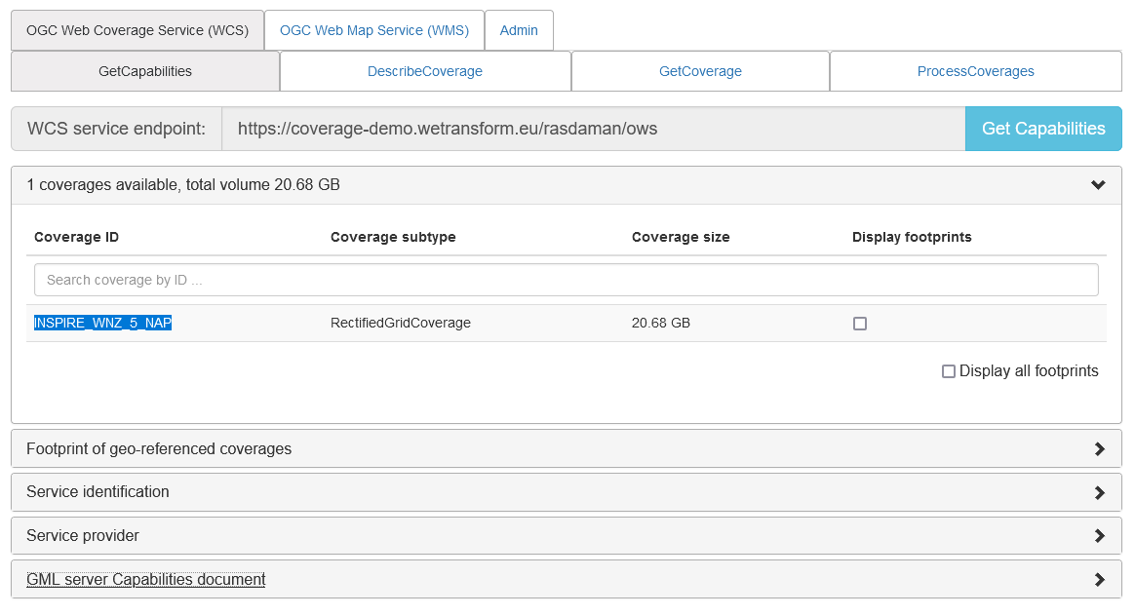
WCS Requests - GetCapabilities Easier
Rasdaman endpoint provides simple GUI https://coverage-demo.wetransform.eu/rasdaman/ows

Slide 40
WCS Requests - DescribeCoverage
Indepth information on a specific coverage, includes
Domain: area and resolution for which data is provided, the grid
RangeType: information on the values being provided
Coverage Metadata Element content (XML Snippet)
Request Structure: https://{WCS Endpoint}/ows? SERVICE=WCS& VERSION=2.0.1& REQUEST=DescribeCoverage& COVERAGEID=INSPIRE_WNZ_5_NAP

Slide 41
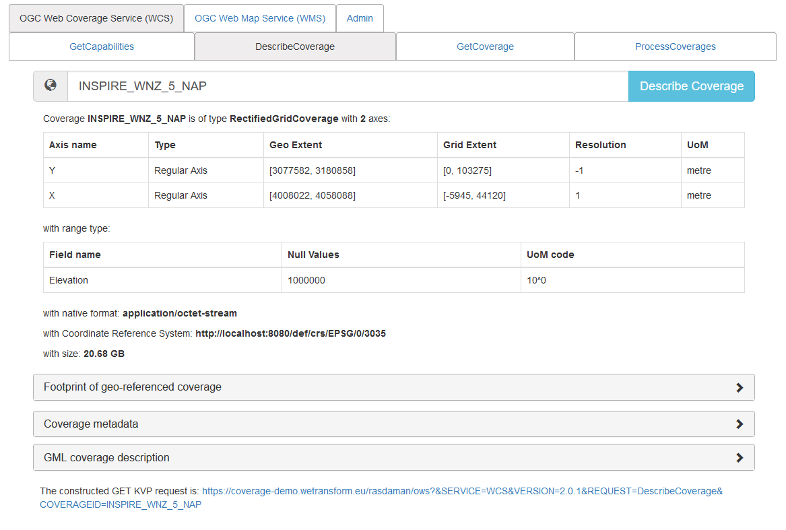
WCS Requests – DescribeCoverage Response

Slide 42
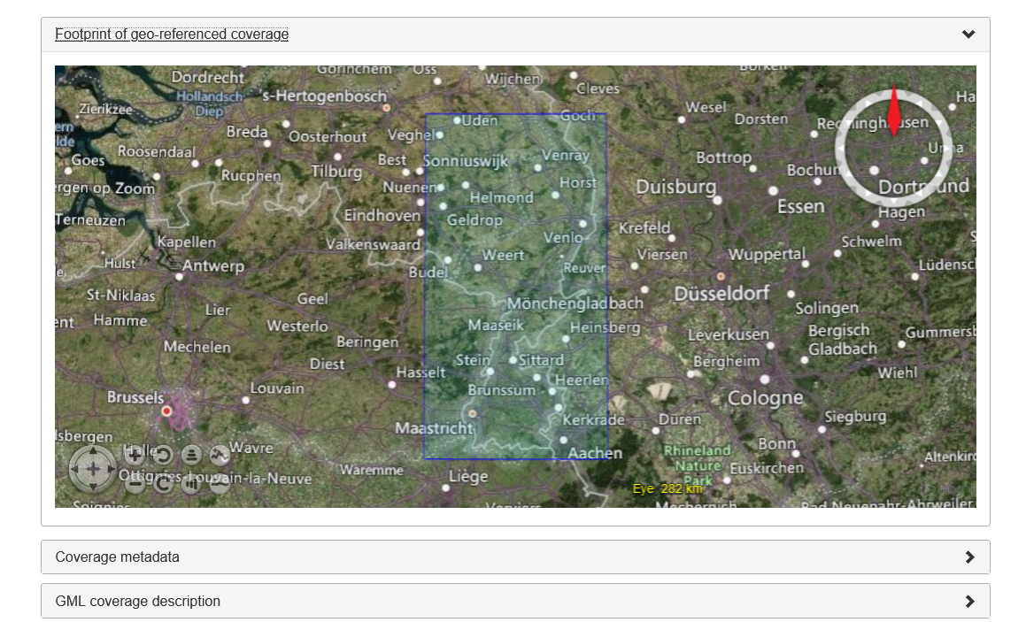
WCS Requests – DescribeCoverage - Footprint

Slide 43
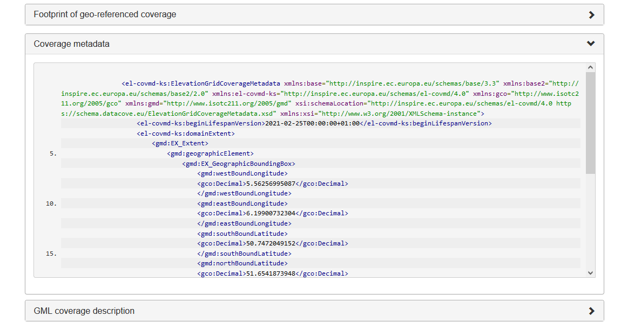
WCS Requests - DescribeCoverage

Slide 44
WCS Requests - GetCoverage
Request the Coverage Range (the VALUES!)
Various formats available, Tif useful
Request Structure: https://{WCS Endpoint}/ows? SERVICE=WCS& VERSION=2.0.1& REQUEST=GetCoverage& COVERAGEID=INSPIRE_WNZ_5_NAP& FORMAT=image/tiff & SUBSET=Y(3117600,3124600)& SUBSET=X(4024000,4031000)
Supported formats in GetCapabilities (many!)

Slide 45
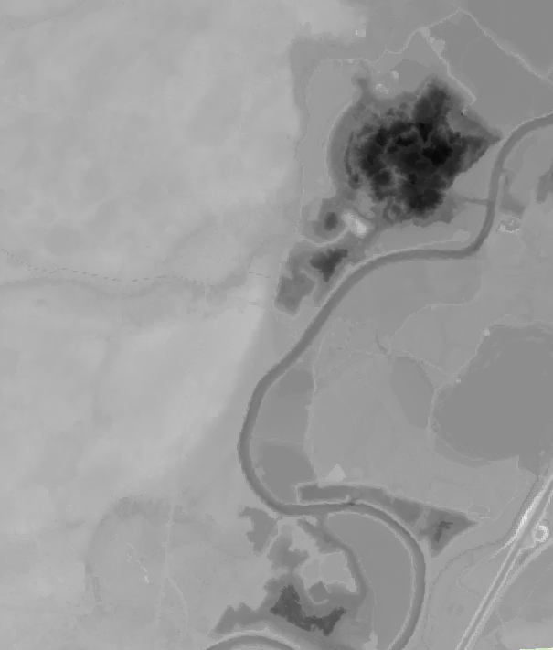
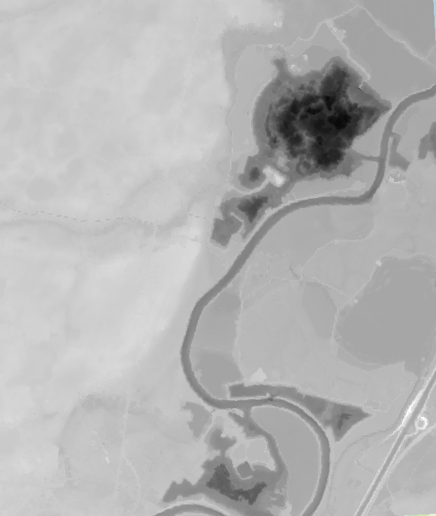
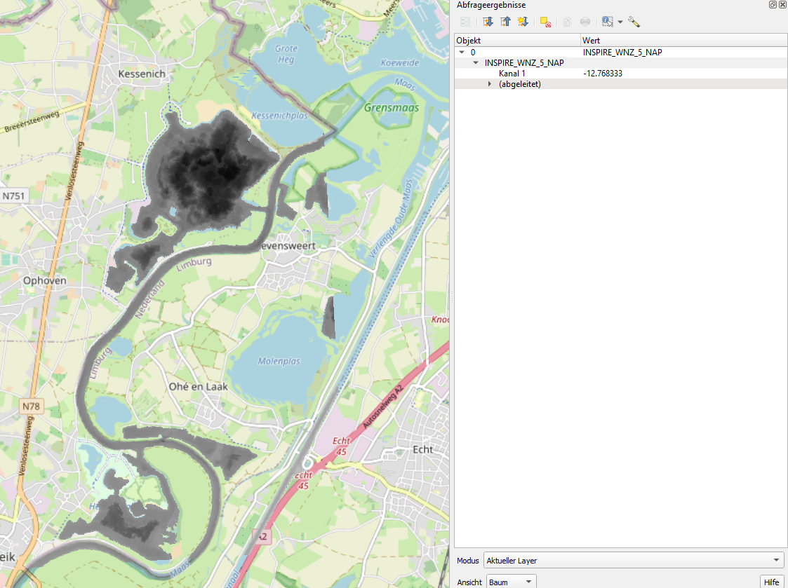
Coverage Reality Bites!

Slide 46
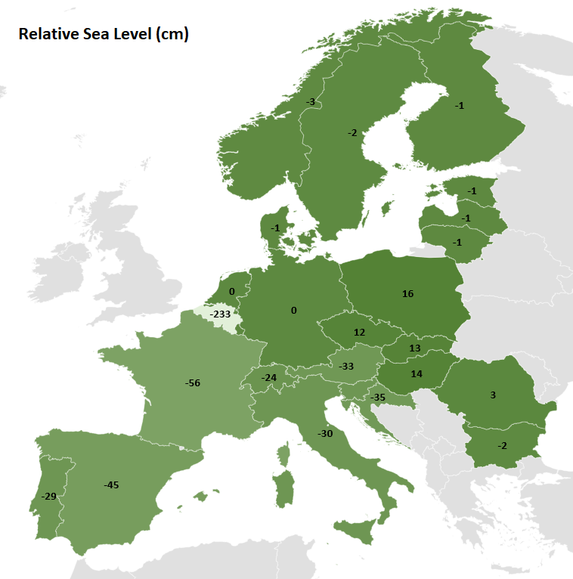
European Sea Levels
Different European Countries use different Datum (Pegel), e.g.:
NL: Amsterdam Ordnance Datum or Normaal Amsterdams Peil (NAP)
FR: mètres au-dessus du niveau de la mer (m) – Marseille
IT: metri sul livello del mare (m s.l.m.) – Genua
Source: https://de.wikipedia.org/wiki/Höhe_über_dem_Meeresspiegel#Höhenangaben_in_der_Seefahrt

Slide 47
Issues Encountered
XML Snippet Schema must be formalized
Will be submitted to the INSPIRE Coverage Good Practice
What values to provide where canals cross?
Relative sea levels
While vertical CRS exist, not being utilized, conversion tools missing
INSPIRE Requires use of EVRF2000
EVRF2019 mean-tide height - EPSG:9390 being added to INSPIRE CRS
Formalization of Range Type including vertical CRS still to-do
GIS Tools cannot access WCS 2
Download TIF via GetCoverage from a browser

Slide 48
WCS Requests
NL Bathymetry: https://coverage-demo.wetransform.eu/rasdaman/ows? SERVICE=WCS&VERSION=2.0.1& REQUEST=GetCoverage& COVERAGEID=INSPIRE_WNZ_5_NAP& SUBSET=Y(3117600,3124600)& SUBSET=X(4024000,4031000)& FORMAT=image/tiff
BE Elevation: http://sandbox.datacove.eu:8080/rasdaman/ows? SERVICE=WCS&VERSION=2.0.1& REQUEST=GetCoverage& COVERAGEID=INSPIRE_BE_Limburg& SUBSET=Y(3117600,3124600)& SUBSET=X(4024000,4031000)& FORMAT=image/tiff

Slide 49
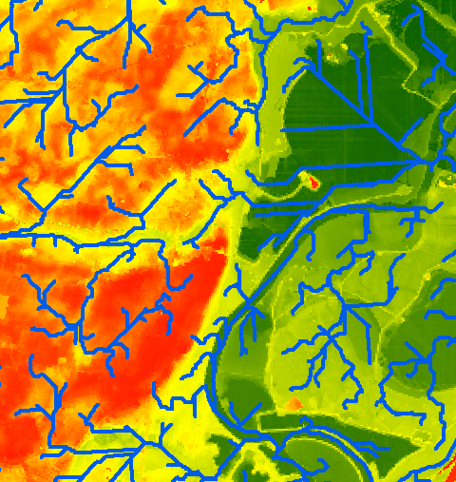
WCS in Action
Introducing Patrick Groeneweg…
General Viewing
Adjusting the 2 National Elevations
Generating a Flow Path Map
(Start collecting your questions!)

Slide 50


Discussion
https://github.com/INSPIRE-MIF/helpdesk
https://github.com/codefornl/INSPIRE-coverages
Notes:
Is all required information clear?
What else do you want to know? – provision and use
How could this be made more useful for you?
What would you do with this data, and what further data would you need?
What further ideas do you have?
What was your experience?

Slide 51
Expectations Fulfilled? Share the experiences Collect questions and answers Discuss how to use the results Define actions

Slide 52
Endpoints
Elevation WCS
NL Elevation: https://coverage-demo.wetransform.eu/rasdaman/ows#/services
BE Elevation Mirror: http://sandbox.datacove.eu:8080/rasdaman/ows
To make things more interesting, we’ve also added OGC SensorThings API* to the mix with water level data:
https://ogc-demo.k8s.ilt-dmz.iosb.fraunhofer.de/v1.1/
* SensorThings is also an INSPIRE Good Practice

Slide 53
Brought to you by:
INSPIRE services RWS
DataCove
wetransform - Data modelling and transformation
Engineering consultancy Sweco
Rijkswaterstaat
November 2021

